Slide 1


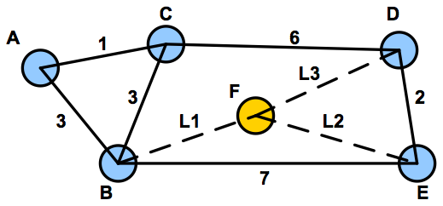
Ant Colony Optimization to Find Shortest Path
Prepared by
Mohammad Mominur Rahman
Ph.D. Student (ID: 210028982), Computer Science and Engineering, HBKU, Qatar.

Slide 2

Contents
Introduction
How does ant colony optimization work?
Problem formulation
ACO algorithm and formula
ACO numerical example.
Model Descriptions and Evaluation
Result Observe
Applications of ACO
Advantage and disadvantage.
Conclusion and Future Scope

Slide 3
Introduction
In computer science and operations research, the ant colony optimization algorithm (ACO) is a probabilistic technique for solving computational problems which can be reduced to finding good paths through graphs.
The Ant Colony Optimization algorithm was developed by M. Dorigo in the late 90s as a part of his PhD thesis.[1]
In a series of experiments on a colony of ants with a choice between two unequal length paths leading to a source of food, biologists have observed that ants tended to use the shortest route.
A model explaining this behavior is as follows: An ant runs more or less at random around the colony. If it discovers a food source, it returns more or less directly to the nest, leaving in its path a trail of pheromone.

Slide 4
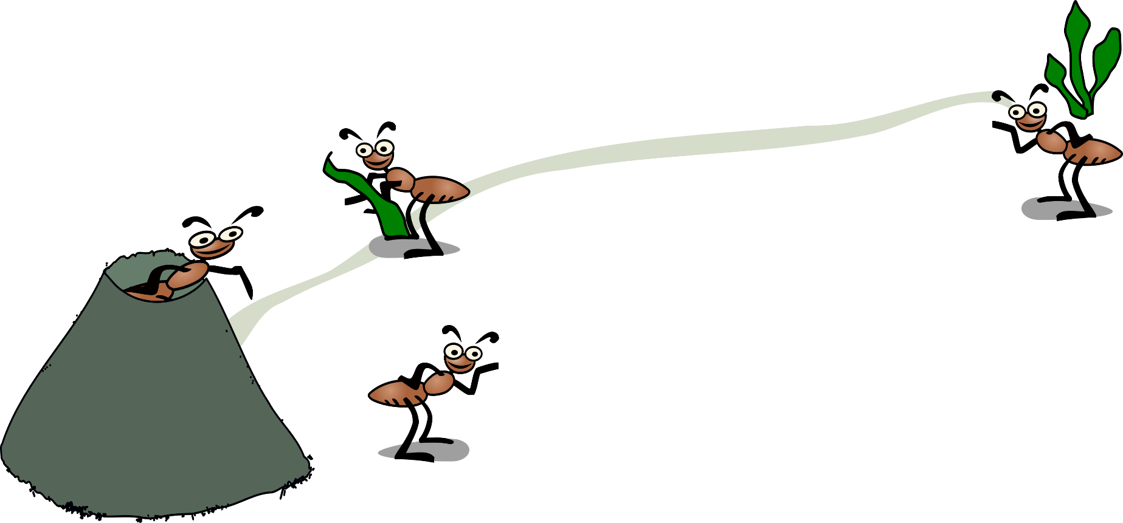
How does ant colony optimization work?
ACO algorithm is basically inspired by the foraging behavior of ants searching for suitable paths between their colonies and food source.
Ants communicate with each other indirectly using a chemical knows as a pheromone. With the help of pheromone signals ants can easily find shortest paths between colony and food.
Ants Foraging behavior
When ants find food source they choose the way have strong pheromones.
Pheromone marks on the shorter paths have strong pheromone signal. Probability of this path selected by other ants increase.
Pheromones evaporate.

Slide 5




Problem formulation
In Travelling salesman problem (TSP) [2] salesman want to visit each city exactly once with minimum travelling distance.
City X
List of cities salesman want to visit.
City X
City Y
City Z
City Y
Task
Find shortest route
2. Visit each city exactly once.
3. Return to the current city
City Z

Slide 6
ACO algorithm and formula
To apply an ant colony algorithm, the optimization problem needs to be converted into the problem of finding the shortest path on a weighted graph. In the first step of each iteration, each ant stochastically constructs a solution, i.e. the order in which the edges in the graph should be followed. In the second step, the paths found by the different ants are compared. The last step consists of updating the pheromone levels on each edge.
Algorithm Step by step:
Initialize ACO parameters
Ant Solution construction
Position each ant in the starting node.
Each ant will select next node by applying state transition rule.
Repeat until ant build the best solution, then compute the fitness value.
Update best solution
Apply offline pheromone update.
Display the best result.
Pseudo code
procedure ACO_MetaHeuristic is
while not terminated do
generateSolutions()
daemonActions()
pheromoneUpdate()
repeat
end procedure

Slide 7




ACO algorithm and formula
A simple transition rule (probability) for choosing the next city to visit, is
where T_{i j}(t) is the pheromone intensity on edge (i, j) between cities i and j, the k-th ant is denoted by k, α is a constant, and C_{i,k} is the set of cities ant k still have to visit from city i.
where α and ß are adjustable parameters that control the weight of pheromone intensity.
Visibility factor,
(Path values)
The Euclidean distance between cities i and j,

Slide 8



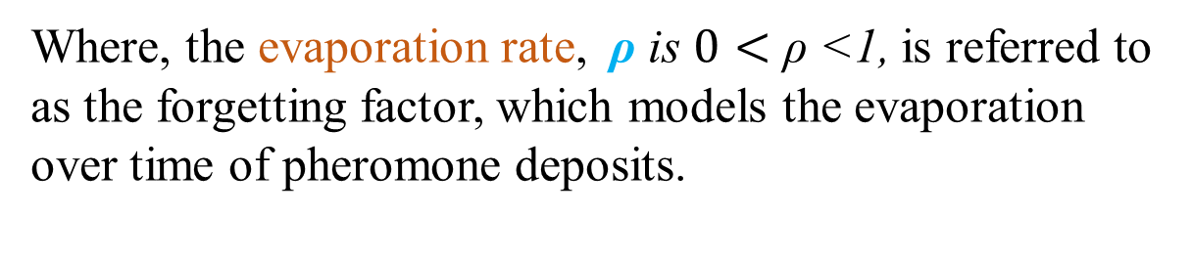
ACO algorithm and formula
At the end of each route, T_{k}, constructed by ant k, the pheromone intensity T_{ij} on the edges of that route is updated, using
Where, the evaporation rate, ρ is $0<\text{ρ}\text{ <1,}$ is referred to as the forgetting factor, which models the evaporation over time of pheromone deposits.
The parameter Q has a value of the same order of the length of the optimal route, L_{k}(t) is the length of the route traveled by ant k, and m is the total number of ants.

Slide 9
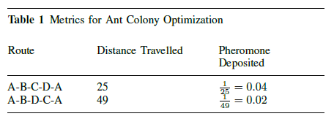
ACO numerical example
Here is an example implementation of the ACO algorithm. A sample graph with 4 vertices and 6 edges. An ant has to travel starting from vertex A and reach back to the same node after traversing the graph
D
7
C
16
4
5
17
D
0.06
C
A
B
0.02
9
0.04
0.04
The brown ant and green ant have both traveled across the edge A-B, pheromones from both the ants will be deposited on the edge A-B. Consequently, the pheromone deposited on this edge will be 0:04 + 0:02 = 0:06
0.02
A
B
0.06

Slide 10

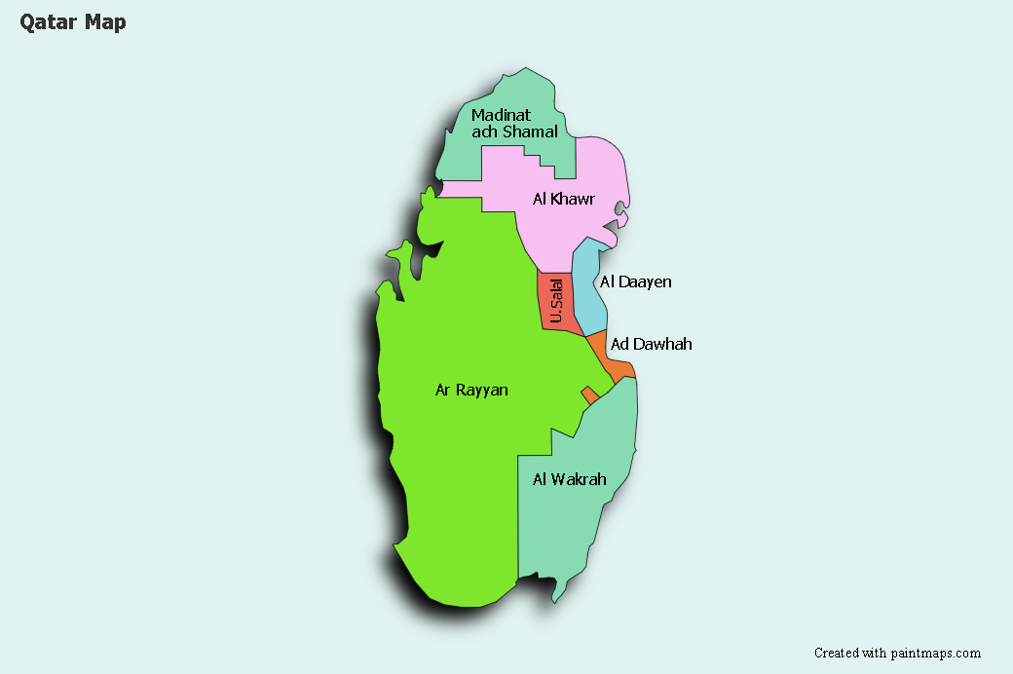
Model Descriptions and Evaluation
First, let us define a map of cities for Qatar. Our input map picture dimension is 1064x692, therefore every cities input direction will be as this:
Ar Rayyan": (450, 450), "Al Dawhah": (615, 350), "U. Salal": (555, 300), "Al Daayen": (600, 300),"Al Khawar": (600, 185), "Madinat ash Shamal": (480, 160), "Al Wakrah": (580, 550)

Slide 11
Model Descriptions and Evaluation
time=0, # run for a fixed amount of time
min_time=0, # minimum runtime
timeout=0, # maximum time in seconds to run for
stop_factor=2, # how many times to redouble effort after new best path
min_round_trips=10, # minimum number of round trips before stopping
max_round_trips=0, # maximum number of round trips before stopping min_ants=0, # Total number of ants to use
max_ants=0, # Total number of ants to use
ant_count=64, # this is the bottom of the near optimal range for numpy performance
ant_speed=1, # how many steps do ants travel per epoch
distance_power=1, # power to which distance affects pheromones
pheromone_power=1.25, # power to which differences in pheromones are noticed
decay_power=0, # how fast do pheromones decay
reward_power=0, # relative pheromone reward based on
best_path_length/path_length
best_path_smell=2, # queen multiplier for pheromones upon finding a new best path
start_smell=0, # amount of starting pheromones

Slide 12
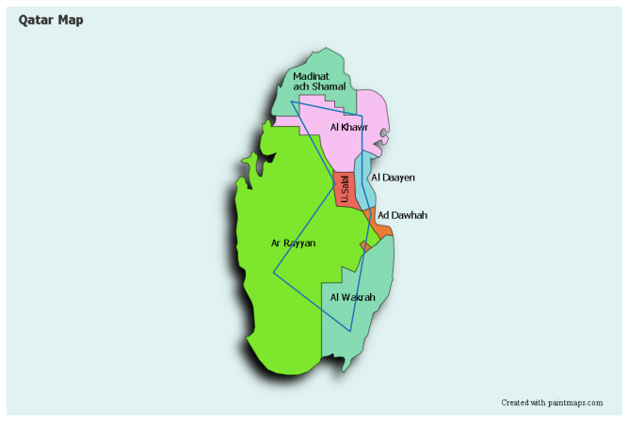
Result Observe
{'path_cost': 1080, 'ants_used': 1, 'epoch': 832, 'round_trips': 1, 'clock': 0} {'path_cost': 1069, 'ants_used': 2, 'epoch': 859, 'round_trips': 1, 'clock': 0} {'path_cost': 1018, 'ants_used': 9, 'epoch': 905, 'round_trips': 1, 'clock': 0} {'path_cost': 1000, 'ants_used': 81, 'epoch': 1928, 'round_trips': 2, 'clock': 0} {'path_cost': 997, 'ants_used': 132, 'epoch': 2692, 'round_trips': 3, 'clock': 0}
Finally for 7 cities salesman need to travel 998 distance instead of 1242, which is found by 565 ants who travel 10 times to update the pheromone_power on a total of 1778 epoch.

Slide 13
Applications
Scheduling problem
Sequential ordering problem (SOP)
Job-shop scheduling problem (JSP)
Open-shop scheduling problem (OSP)
Permutation flow shop problem (PFSP)
Vehicle routing problem
Capacitated vehicle routing problem (CVRP)
Multi-depot vehicle routing problem (MDVRP)
Period vehicle routing problem (PVRP)
Assignment problem
Quadratic assignment problem (QAP)
Generalized assignment problem (GAP)
Frequency assignment problem (FAP)
Redundancy allocation problem (RAP)

Slide 14
Advantage and disadvantage.
Advantage:
Retains memory of entire colony instead of previous generation only.
Less affected by poor initial solutions (due to the combination of random path selection and colony memory).
Has been applied to a wide variety of applications.
Disadvantage:
Theoretical analysis is difficult:
Due to sequences of random decisions.
Probability distribution changes by iteration.
Convergence is guaranteed, but time to convergence uncertain.
Coding is somewhat complicated, not straightforward. Pheromone “trail” additions/deletions, global updates and local updates.

Slide 15
Conclusion and Future Scope
The operation is time-consuming as the algorithm tries to walk through all the paths initially until it can identify the best path. The approach has been kept as generic as possible so that it can be easily incorporated into any swarm-led intelligence models for optimization.
Several hyperparameters can be tuned for future work. The code has been made open-source and available for re-use and improvement [3].

Slide 16
References
A. Colorni, M. Dorigo et V. Maniezzo, Distributed Optimization by Ant Colonies, actes de la première conférence européenne sur la vie artificielle, Paris, France, Elsevier Publishing, 134-142, 1991.
Traveling Salesman Problem at the Wayback Machine (archived 17 December 2013) at University of Waterloo. https://en.wikipedia.org/wiki/Travelling_salesman_problem
https://github.com/momin128/Mominur.git

Slide 17


